Slide 1

Internet Technologies
ITI & XI-IT
Lesson 8: API’s, REST & SOAP
Henrik Lange

Slide 2
Plan
Week 1: HTML & CSS
Week 2: JavaScript
Week 3: HTTP, PHP & AJAX (march 1st)
Week 4: MariaDB / MySQL (march 8th)
Week 5: Recap, Internet History, Project help (march 15th)
Week 6: Project Hand-In (march 22nd)
Week 6: OOP PHP, MVC, Routers, Reflection
Week 6: Midway Evaluation
Week 7: Project Presentation (march 29th)
Week 7: Assignment 2 specification
Week 8: API’s, REST & SOAP
Week 9: Libraries & Frameworks
(Bootstrap, jQuery, Leaflet, Google Charts)
Week 10: Search Engine Optimization and Advertising
Week 11: ASP .net LINQ scaffolding, A2 hand-in
Week 12: Presentations, Feedback, Recap, Exam Questions

Slide 3
Agenda
What is an API?
REST
JSON
PHP JSON
SOAP
XML
PHP XML
Examples
Assignment API specifications

Slide 4
What is an API?
Application Programming Interface
“a set of functions and procedures allowing the creation of applications that access the features or data of an operating system, application, or other service”
A way to expose data and functionality from one application to others
Supplier application has an API
Consumer application uses an API
An application can be a consumer and supplier simultaneously
An application can use its own API internally

Slide 5
REST
Representational State Transfer
A uniform way of cross application communication
Usually uses JSON, but can use XML
URL’s define resources
HTTP verbs define actions

Slide 6
URL’s
URL’s are formed with forward slashes
No file extensions
No capital letters, special characters or underscores
Hyphens (-) can be used if necessary (spinal case)
GET myservice.com/v1.2/users
GET myservice.com/v1.2/user/4/posts
Proper HTTP verbs are used
GET gets data without changing anything
POST uploads new data to a service
PUT changes existing data
DELETE removes existing data
GET, PUT & DELETE are idempotent

Slide 7
Hypermedia Controls
Contains data about how to use the current data
Example
You request a list of users
The REST response will return a list of users AND a list of further requests you can make to more info on a specific user
Also known as HATEOAS
Hypertext As The Engine Of Application State

Slide 8
Versioning
Myservices.com/v1.2.3/users
Third digit (x.x.3) increments with any new release
Bug fixes
Second digit (x.2.x) increments when additions are made
New functionality, but existing functionality stays the same
First digit (1.x.x) increments when something is changed and consumers can no longer expect the same exact behavior from existing calls

Slide 9
Richardson’s REST Maturity Model
Level 0
The swamp of POX
Plain old XML
Is often JSON, but occasionally, XML is used
Level 1
Resources
Well formed URL’s that explain the request
Level 2
Methods
HTTP Methods used correctly
HTTP Status codes used correctly
Level 3
Hypermedia Controls
https://martinfowler.com/articles/richardsonMaturityModel.html

Slide 10
JSON
JavaScript Object Notation
Open-standard human readable file format .json
“key” : “value”, “key” : “value”
{ } : object
[ ] : array
Json file example:
{
“name” : “Jack”,
“age” : 29,
“possessions” : {
“cars” : [“BMW”, “Ford”]
}
}

Slide 11
JSON
Return multiple objects in arrays
[
{
"name" : "jack",
"age" : 30,
"possessions" : {
"cars" : ["BMW", "Ford"]
}
},
{
"name" : "Joe",
"age" : 20,
"possessions" : {
"cars" : []
}
}
]

Slide 12
PHP JSON
json_decode($string)
json_encode($object)
print_r($object)
foreach($object as $key => $value) { … }
In PHP, objects and arrays are similar enough that you can cast one to the other
$string = file_get_contents(‘URI’);
For external services, not internal!
Loading internal services will load unprocessed code instead of json result
To load generated json, either save it in a file or use 2 php instances

Slide 13
PHP Create JSON
class Person {
public $name;
public $age;
public $possessions = [];
public function __construct($name, $age, $possessions) {
$this->name = $name;
$this->age = $age;
$this->possessions = $possessions;
}
}
$jack = new Person("Jack", 32, ["Mercedes", "Toyota"]);
$jill = new Person("Jill", 29, []);
$people = [$jack, $jill];
$json = json_encode($people, JSON_PRETTY_PRINT);
header('Content-Type: application/json');
echo $json;
[
{
"name": "Jack",
"age": 32,
"possessions": [
"Mercedes",
"Toyota"
]
},
{
"name": "Jill",
"age": 29,
"possessions": []
}
]

Slide 14
PHP Consume JSON
[
{
"name": "Jack",
"age": 32,
"possessions": [
"Mercedes",
"Toyota"
]
},
{
"name": "Jill",
"age": 29,
"possessions": []
}
]
$json = file_get_contents('people.json');
$arr = json_decode($json);
//specific value of property in object in array
echo 'age 0 : ' . $arr[0]->age . '<br/>';
foreach ($arr as $obj ) {
foreach ($obj as $key => $value) {
if(is_object($value)) {
print_r ($value);
} else {
echo $key . ' + ' . $value . '<br/>';
}
}
}

Slide 15
SOAP
Simple Object Access Protocol
Always uses XML
Fewer URI’s
Strongly typed
Strict protocol

Slide 16
XML
eXtensible Markup Language
HTML is a form of XML
<element attribute=“value”>elementValue</element>
<singleTagElement />

Slide 17
XSD
XML can be defined in XSD
XML Schema Definition
An describes the structure of the XML
Fields, types, restrictions, optional fields
An XML library can automatically check the structure of XML against an XSD

Slide 18
XSD Example
<?xml version="1.0" encoding="UTF-8" ?> <xs:schema xmlns:xs="http://www.w3.org/2001/XMLSchema"> <xs:element name="shiporder"> <xs:complexType> <xs:sequence> <xs:element name="orderperson" type="xs:string"/> <xs:element name="shipto"> <xs:complexType> <xs:sequence> <xs:element name="name" type="xs:string"/> <xs:element name="address" type="xs:string"/> <xs:element name="city" type="xs:string"/> <xs:element name="country" type="xs:string"/> </xs:sequence> </xs:complexType> </xs:element> <xs:element name="item" maxOccurs="unbounded"> <xs:complexType> <xs:sequence> <xs:element name="title" type="xs:string"/>
<xs:element name="note" type="xs:string" minOccurs="0"/> <xs:element name="quantity" type="xs:positiveInteger"/> <xs:element name="price" type="xs:decimal"/> </xs:sequence> </xs:complexType> </xs:element> </xs:sequence> <xs:attribute name="orderid" type="xs:string" use="required"/> </xs:complexType> </xs:element> </xs:schema>

Slide 19
WSDL
Web Services Description Language
Describes a service and its operations
<message name="getTermRequest"> <part name="term" type="xs:string"/> </message> <message name="getTermResponse"> <part name="value" type="xs:string"/> </message> <portType name="glossaryTerms"> <operation name="getTerm"> <input message="getTermRequest"/> <output message="getTermResponse"/> </operation> </portType>

Slide 20
SOAP XML
In SOAP, the XML is in an envelope
<?xml version="1.0"?> <soap:Envelope xmlns:soap="http://www.w3.org/2003/05/soap-envelope/" soap:encodingStyle="http://www.w3.org/2003/05/soap-encoding"> ... Message information goes here ... </soap:Envelope>

Slide 21
PHP XML
XML is not natively supported by PHP
PHP support for XML is spotty and works better with external libraries or custom methods
https://stackoverflow.com/questions/137021/php-object-as-xml-document

Slide 22
SOAP vs REST
Browser
resource
HTML
application
resource
client
HTTP
resource
REST
JSON/XML
resource
client
HTTP
resource
resource
SOAP
Envelope
XSD
application
resource
XML
resource
client
HTTP
resource

Slide 23
SOAP vs REST
SOAP | REST
XML-based message protocol | Architectural style protocol
Uses WSDL for communication between consumer and provider | Uses XML or JSON to send and receive data
Invokes multiple services through single endpoint | Calls services via URL
Result is enveloped XML | Result is plain XML or JSON
JavaScript can call SOAP, but it is difficult to implement | Easy to use with JavaScript (JSON, that is)
Performance is often slower than REST | Performance is often better than SOAP
Strongly typed | Weakly typed

Slide 24
Why SOAP then?
For business critical operations, extra validation is more important than speed and ease of use
Imagine a banking application – we don’t want fast or easy, we want correct
If we use an API to get a random picture of a dog – we want fast and easy. Correctness does not matter
Do not confuse correctness for security – REST is plenty secure

Slide 25
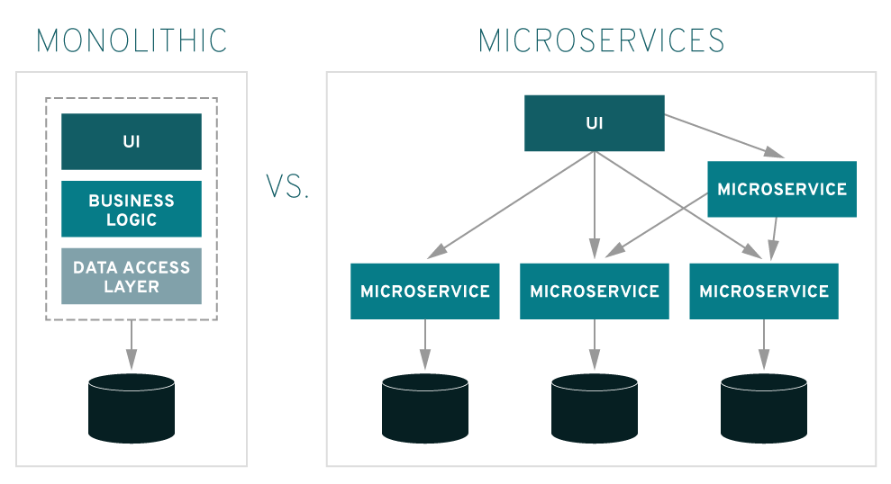
Microservices
Source: https://www.redhat.com/en/topics/microservices/what-are-microservices

Slide 26
Microservices
Everything is a service
Each service may have its own database, share a database or use no database
Each service may use other services or no other services
Front end can be completely clear of backend and just call the relevant services
Same services can be used for front end, apps and API’s

Slide 27
API Examples
Why do we use API’s?

Slide 28
API Examples
Avoid reinventing everything
Getting information from specific services
Harvesting rich meta data

Slide 29
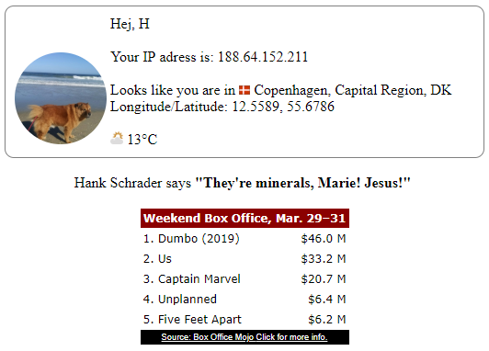
API Examples

Slide 30
API Examples
FourTonFish.com provides a “Hello” in a specified language
Random.dog provides a random dog on each call
Ip-address from PHP server
API “ipapi.co” provides location from an IP address
breaking-bad-quotes.herokuapp.com provides a random quote from BB.
Metaweather.com provides weather from city name
BoxOfficeMojo provides the top 5 box office for last weekend

Slide 31
API Examples – How?
94 lines of code
Including 30 lines of CSS
Uses 7 API’s

Slide 32
Where to find API’s
https://github.com/toddmotto/public-apis/blob/master/README.md#news
https://www.programmableweb.com/apis/directory?page=1

Slide 33
API Security
In your assignments, you are free to use API’s without security
The API’s you build just use username and password in JSON as security
A normal public API will usually use one of the following types of authentification:
Api-key
A “password” for your application that you get by registering to the service
OAuth

Slide 34
API Key
Some APIs use API keys for authorization. An API key is a token that a client provides when making API calls. The key can be sent in the query string:
or as a request header:
or as a cookie:
API keys are supposed to be a secret that only the client and server know.
Authentication is only considered secure if used together with other security mechanisms such as HTTPS/SSL.
Multiple API keys can be combined
GET /something?api_key=abcdef12345
GET /something HTTP/1.1
X-API-Key: abcdef12345
GET /something HTTP/1.1
Cookie: X-API-KEY=abcdef12345
GET /something?api_key=abcdef1234&app_key=fedcba4321

Slide 35
OAuth
OAuth is based on flows
There are several but the most common looks like this
API
Open
Client
Authorization Server
Redirect
Redirect
Require Consent / Login
Consent / Login
Authorization Code
Authorization Code
Authorization Code
Access token
Access granted

Slide 36
Assignment API specifications
With PHP loaded from the SDU-ITI-F19 folder, expose the following resources
GET localhost:8080/xx/mvc/public/api/users
Returns json containing “user_id” and “username” of all users
GET localhost:8080/xx/mvc/public/api/pictures/user/2
Returns json containing “image_id”, “title”, “description” and “image” for all user 2’s images
Image can be a URL or base64
Make sure database column is of type BLOB
POST localhost:8080/xx/mvc/public/api/pictures/user/2
$_POST[‘json’] will contain json which has
“image” in base64 format, “title”, “description”, “username” & “password”
Returns the “image_id”
If the DB image column is of type BLOB, the image can be saved directly
xx should be replaced with SDU handle
2 can be any user_id

Slide 37
Assignment API test
With PHP loaded from the SDU-ITI-F19 folder
The UI must be available at
localhost:8080/xx/mvc/public
The UI will be used to register a new user and check MVC pattern
GET localhost:8080/xx/mvc/public/api/users
Will be used to find ID of the new user
POST localhost:8080/xx/mvc/public/api/pictures/user/2
Will be used to upload image from new user via ID
GET localhost:8080/xx/mvc/public/api/pictures/user/2
Will be used to load the image(s) that were uploaded in the previous step
xx should be replaced with SDU handle
2 can be any user_id
Username and password is only checked on POST

Slide 38
Assignment API test
Your own API’s will be made with JSON

Slide 39
Next time
We will continue with:
Libraries and Frameworks

